Slide 1
CHAPTER 5 Predictive Control with constraints 1 Introduction
Anthony Rossiter

Slide 2
Why are constraints important?
A key weakness of classical linear control strategies is that they take no account of constraints.
A failure to take account of constraints can lead to disaster as will be demonstrated in this introduction.
One main reason for the success of predictive control is the ability to deal with constraints in a systematic fashion.
Hence, having shown the need, the videos in this chapter will consider how constraints can be incorporated into a control design.

Slide 3
What are constraints?
Most systems only exist within a specified domain. Attempts to go beyond this domain result in undesirable behaviours.
If a system is too hot, components can fail, melt, operate imperfectly and so forth.
If a pressure is to high, a safety value will release.
A valve can only move between 0% and 100% open; expecting more would imply nonsense.
Real physical movement is restricted by walls and other obstacles.
Systems can only move so fast, due to limits in power, energy, grip and so on.
The list could go on.

Slide 4
Ignoring constraints is bad
A simple and obvious example is driving a car.
The aim is to get from A to B as fast as possible.
A simple solution would be to accelerate to top speed and maintain that for the entire duration of the journey.
However, this fails because:
In general cars cannot corner at top speed and attempts to do so result in a crash.
This is also ignoring other practical issues such as rules of the road, other road users, etc.

Slide 5
PI control
Consider the PI control of a tank level system.
The aim is to get the level to a specified depth, but obviously without overflowing and without exceeding the maximum allowable inflow.
Assume the maximum inflow is 2, and assess the following PI control law.
GO TO MATLAB and run
tanklevelanimation2.p
With P=2, I=0.8
See folder constraints_examples

Slide 6
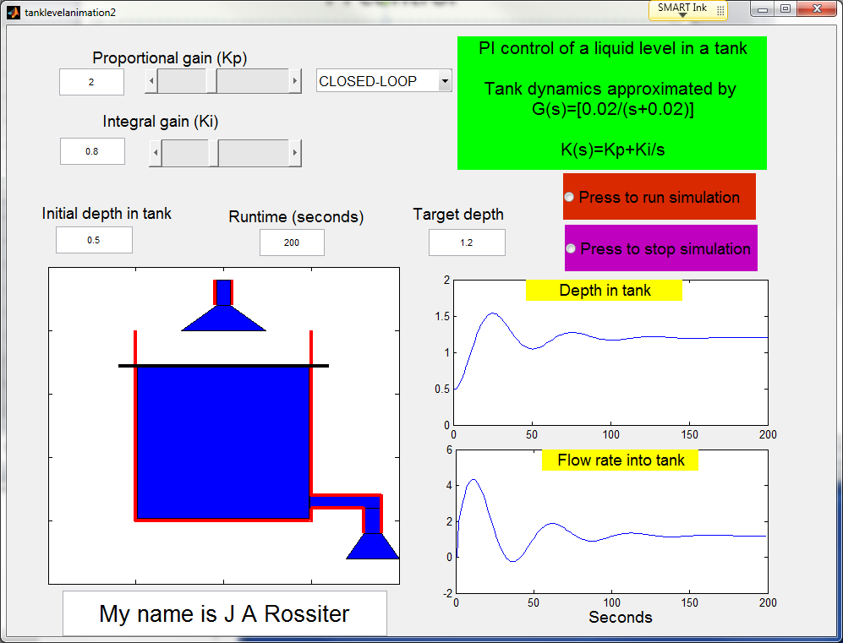
PI control
Tank overflows
Flow larger than possible

Slide 7
What is the problem?
There are two issues:
First the control law has exceeded the maximum input and therefore is proposed values than cannot be implemented. Therefore, the implied linear relationships are no longer valid as the input will saturate.
Similarly, if the tank overflows, the implied saturation means any loop analysis (or tuning) carried out in advance is no longer valid.
What would happened if constraints could be ENFORCED?

Slide 8
Integral wind up
This is a well known problem with a poorly tuned and coded PI compensator.
The integral may still keep increasing, even though the input has saturated. Typically when the integral gain is too large.
This means that even when the error reverses sign, there is no change in the input signal as the integral term has first to wind down again.
The impact on control is self-evident; there is a loss of control as the feedback is essentially disabled.
Consider chap5_simexam1.m

Slide 9
Input still high, even though output too large!
Output slower to converge than if control law recognised the saturation!

Slide 10
With integral saturation the performance is much better!

Slide 11
Non-minimum phase and unstable examples
A simple example is based on something like a segway or inverted pendulum or perhaps a system with a non-minimum phase characteristic.
If the control law does not take the position of the end-stop into account, any strategies it proposes could be seriously flawed.
TARGET – move to the right.
Moves left
Moves right
Moves left again
If arm is still moving right and with too much lean when we hit the end stop, the arm will fall over and we cannot stop it!

Slide 12
Example of an unconstrained MPC law in the presence of constraints
So far the MPC designs offered in this video series have ignored constraints.
Let us compare the behaviour that results from including constraints, and not including constraints in the decision making process.
See file video5_1_example1.m
Dotted lines are the result when there are no constraints.

Slide 13
video5_1_example1.m
Allow different ‘optimal’ values when constraint handling included or excluded, the saturated values would be the same if enforced!
In this case saturation control would be effective, although of cause the optimisation is meaningless.

Slide 14
video5_1_example2.m

Slide 15
Next, enforce saturation even where not included in the optimisation

Slide 16
video5_1_example3
Saturation control gives poor behaviour.
With a smaller constraint on u(k), saturation control is definitely unacceptable.

Slide 17
Summary
A failure to take proper account of constraints during a feedback design can have several undesirable consequences.
In the best case, one could just get suboptimal behaviour but in the worst case one could break a system altogether.
Even a simple saturation policy may come badly unstuck in some scenarios, although it can be shown to be fine for some cases.
There is a need to integrate constraints into the control design in a systematic fashion.

Slide 18




Anthony Rossiter
Department of Automatic Control and Systems Engineering
University of Sheffield
www.shef.ac.uk/acse
© 2014 University of Sheffield
This work is licensed under the Creative Commons Attribution 2.0 UK: England & Wales Licence. To view a copy of this licence, visit http://creativecommons.org/licenses/by/2.0/uk/ or send a letter to: Creative Commons, 171 Second Street, Suite 300, San Francisco, California 94105, USA.
It should be noted that some of the materials contained within this resource are subject to third party rights and any copyright notices must remain with these materials in the event of reuse or repurposing.
If there are third party images within the resource please do not remove or alter any of the copyright notices or website details shown below the image.
(Please list details of the third party rights contained within this work.
If you include your institutions logo on the cover please include reference to the fact that it is a trade mark and all copyright in that image is reserved.)

